Slide 1

AFRICA AIRWAYS CO. AVIATION VENTURE
Presented by: Elizabeth Kiilu

Slide 2
outline
Business Overview
Data Synthesis
Recommendations

Slide 3
Business Overview
Africa Airways Co. has been formed as a subsidiary to venture into the aviation business in the region
The objective is to purchase airplanes with a target market of commercial and private enterprise operations.
To ensure sustainability, risk assessment is a significant factor in ensuring long-term sustainability in the volatile market.
The company targets its operations to be run by low-risk aircrafts with a proven track record in matters of safety and reliability.

Slide 4
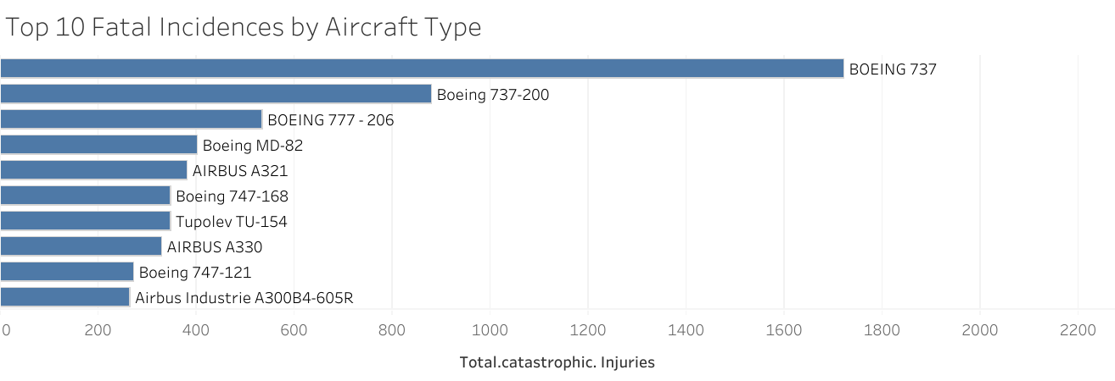
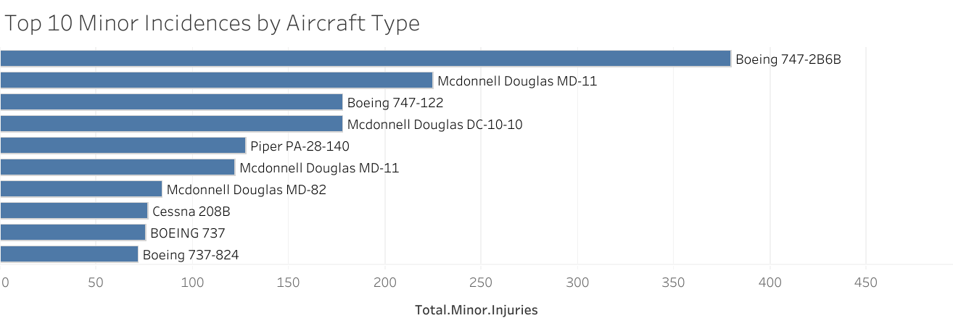
DATA SYNTHESIS Data was acquired showing track records of different flights and their incidence track records
Below are the top ten aircrafts that were involved in incidents that led to fatalities
Below are the top ten aircrafts that were involved in incidents that led to minor injuries.

Slide 5
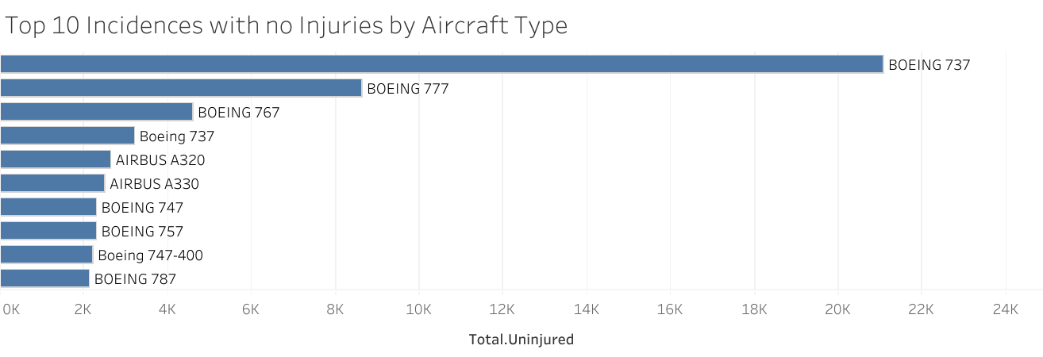
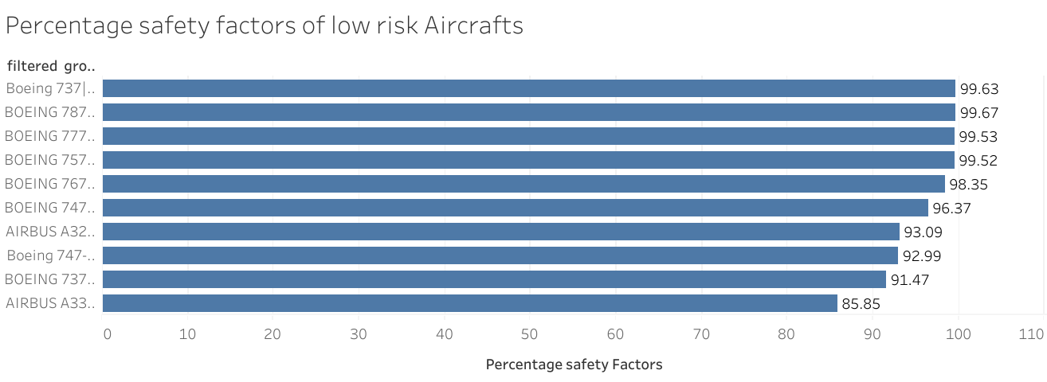
DATA SYNTHESIS The following aircraft were considered low-risk and ranked according to their safety factors.

Slide 6
rECOMMENDATIONs
Africa Airways Co. to venture into low-risk aircraft whose safety factor is high, as highlighted in previous graphs.
01
To ensure high reliability, a threshold of safety factor should guide the selection of aircraft for commercial and private enterprises. The higher the percentage threshold the better.
02
A deeper analysis should be carried out to map out the financial implications of the choice of aircraft to operate and establish a balance between acquisition and operations, and profitability.
03

Slide 7


